Slide 1

CS5 - Comprehensive Well Evaluation: A Deep Dive into Well Analysis Case Study
Batch - 2
SRAVANI MEKA
PRIYADARSINI M S
YASH ROHILLA
AYUSH SOOD
NABIHA KHAN

Slide 2
Problem Statement :
The focal point of this case study is the strategic utilization of the ShaleWellCube database, a comprehensive resource provided by Rystad Energy, housing an extensive repository of data encompassing more than 1.5 million horizontal, fracked vertical, and conventional wells spanning across the regions of the US, Canada, and Argentina.
The core objective of this endeavour is to orchestrate an in-depth exploration into the reservoir of well-related information, meticulously examining historical monthly production records and an array of intricate well attributes.
Augmenting this analysis, the study endeavours to enrich the insights through the integration of projected production figures, inferred parameters, meticulous cost appraisals, breakeven pricing evaluations, NPV and IRR computations, and inclusive coverage of activities related to flaring and venting.

Slide 3
Challenges Faced:
Data processing task was challenging because we had 23 csv tables with each table having many columns.
Finding relationship among tables was challenging because many tables had no common column.
Questions:
1. Historical and Forecast Production?
2. Operators With Highest Well Count?
3. Who are Flaring More?
4. Which shale play has the highest monthly production of oil and gas combined?
5. What is the average well length across all wells in the dataset?
6. How does the monthly production of Ethane compare to that of dry gas for a specific operator?

Slide 4
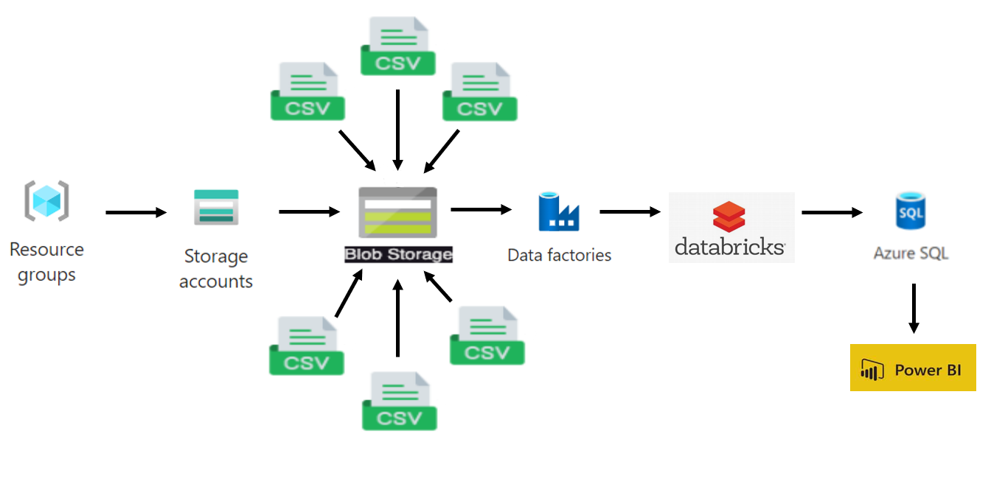

Slide 5
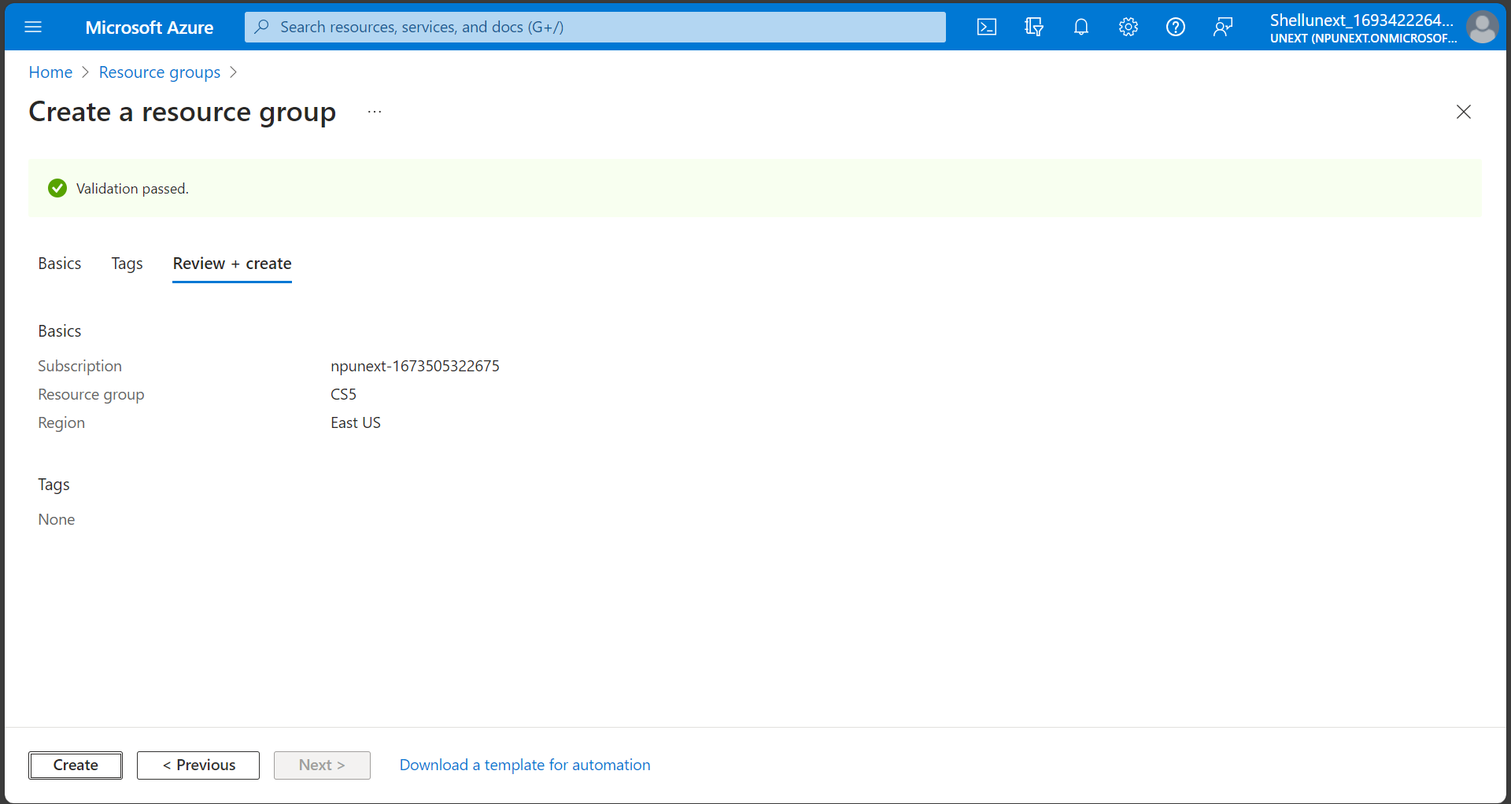
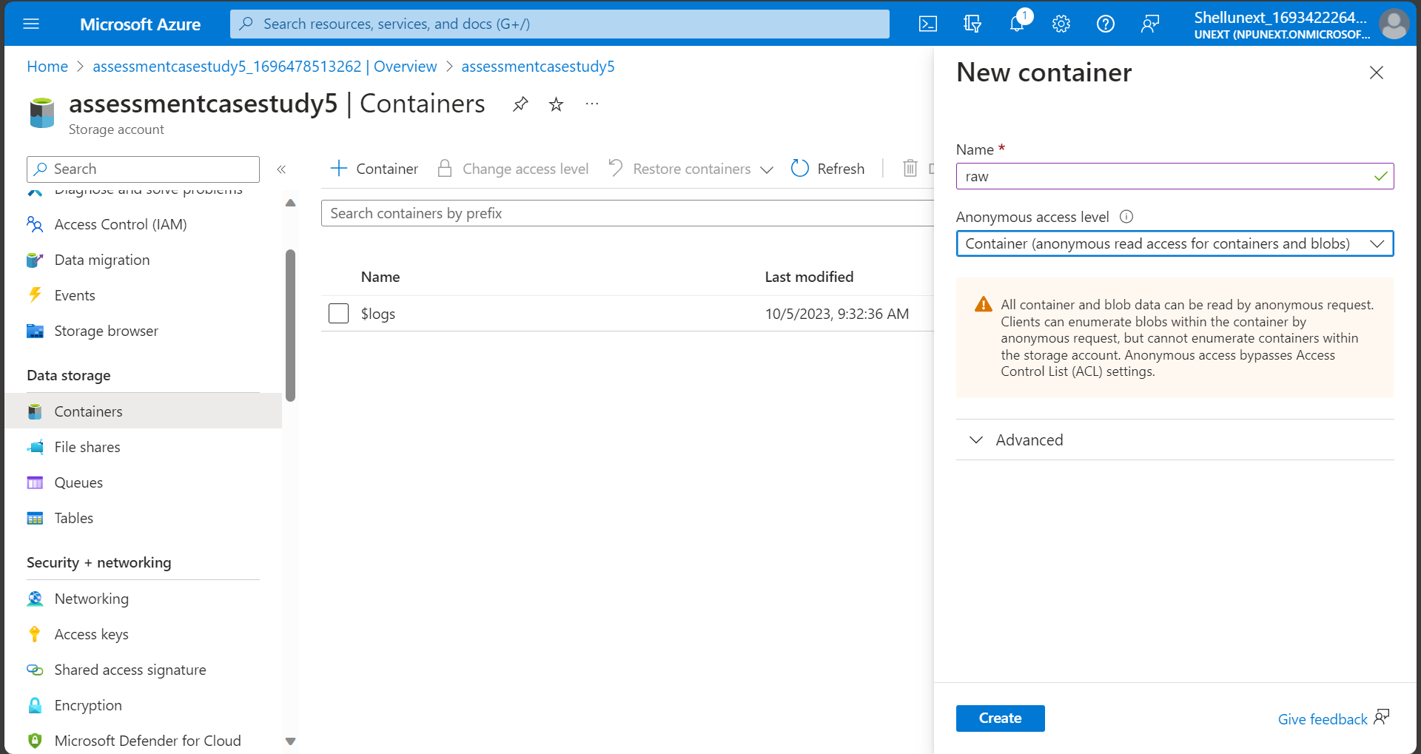
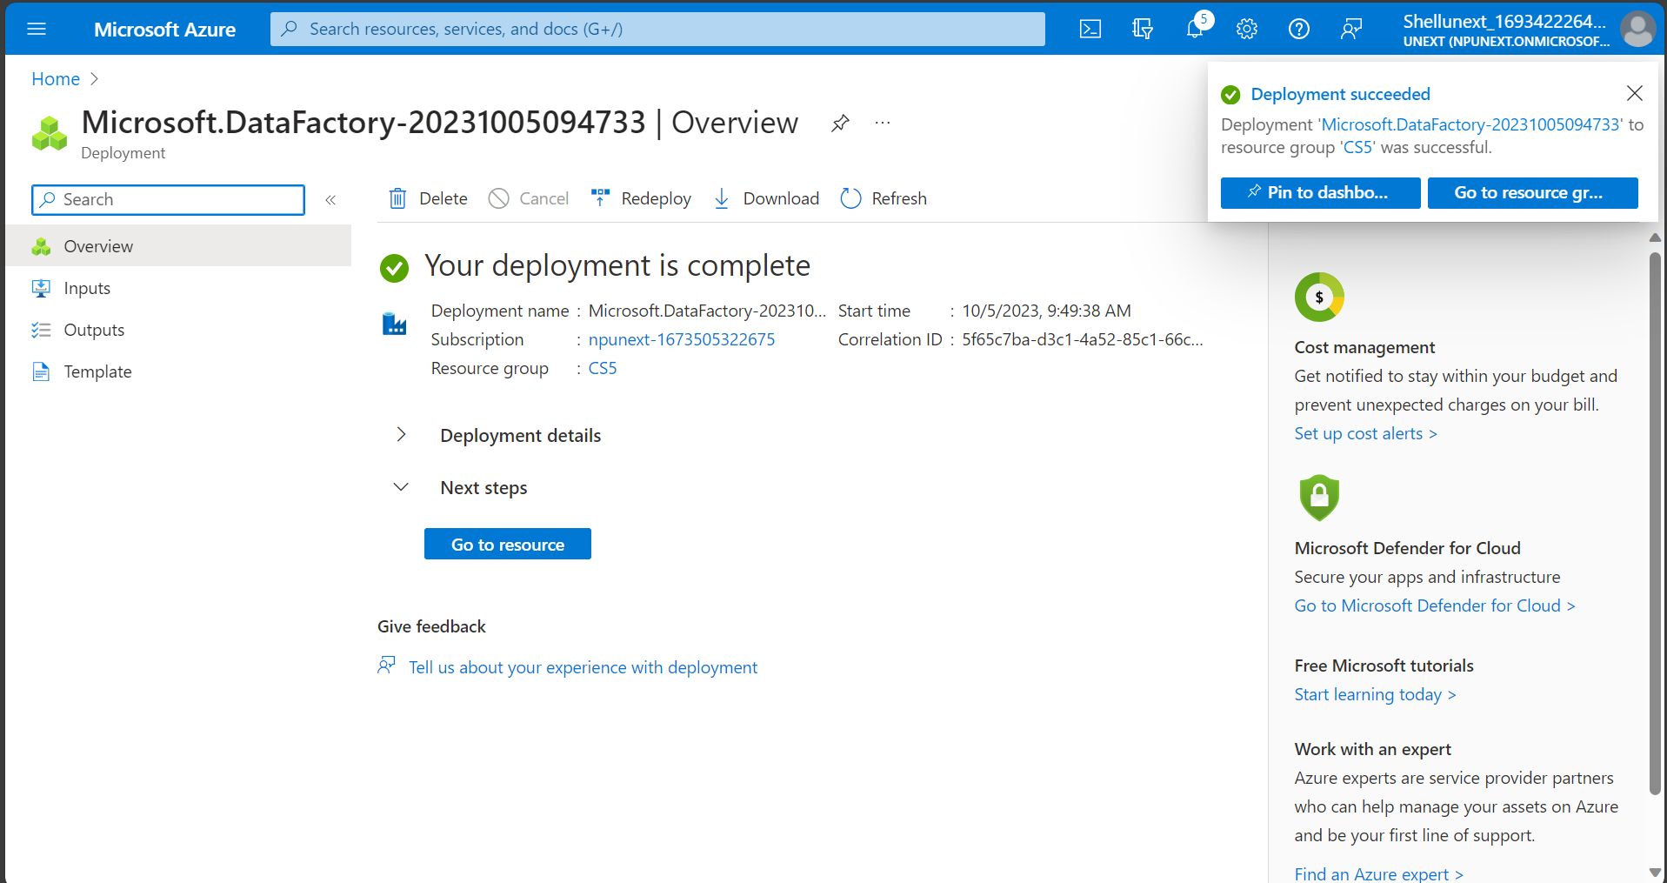
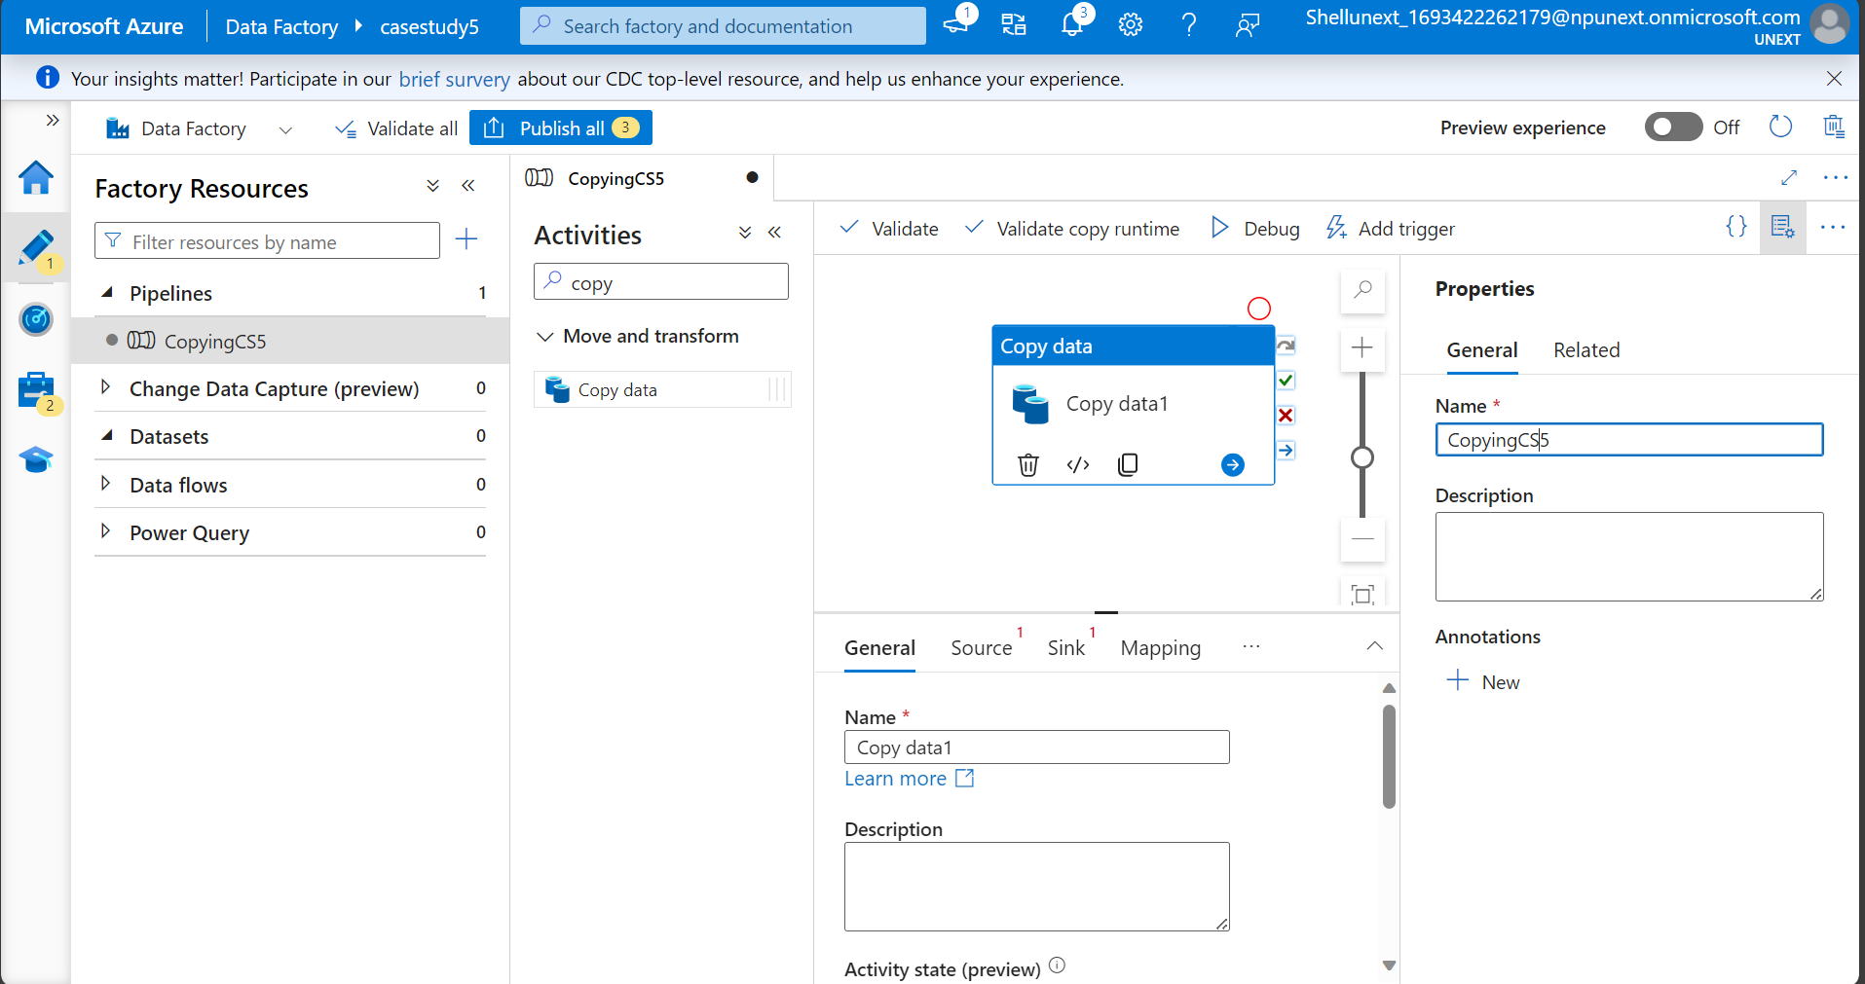

Slide 6
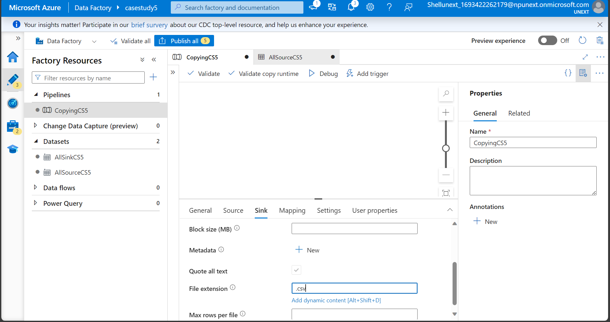
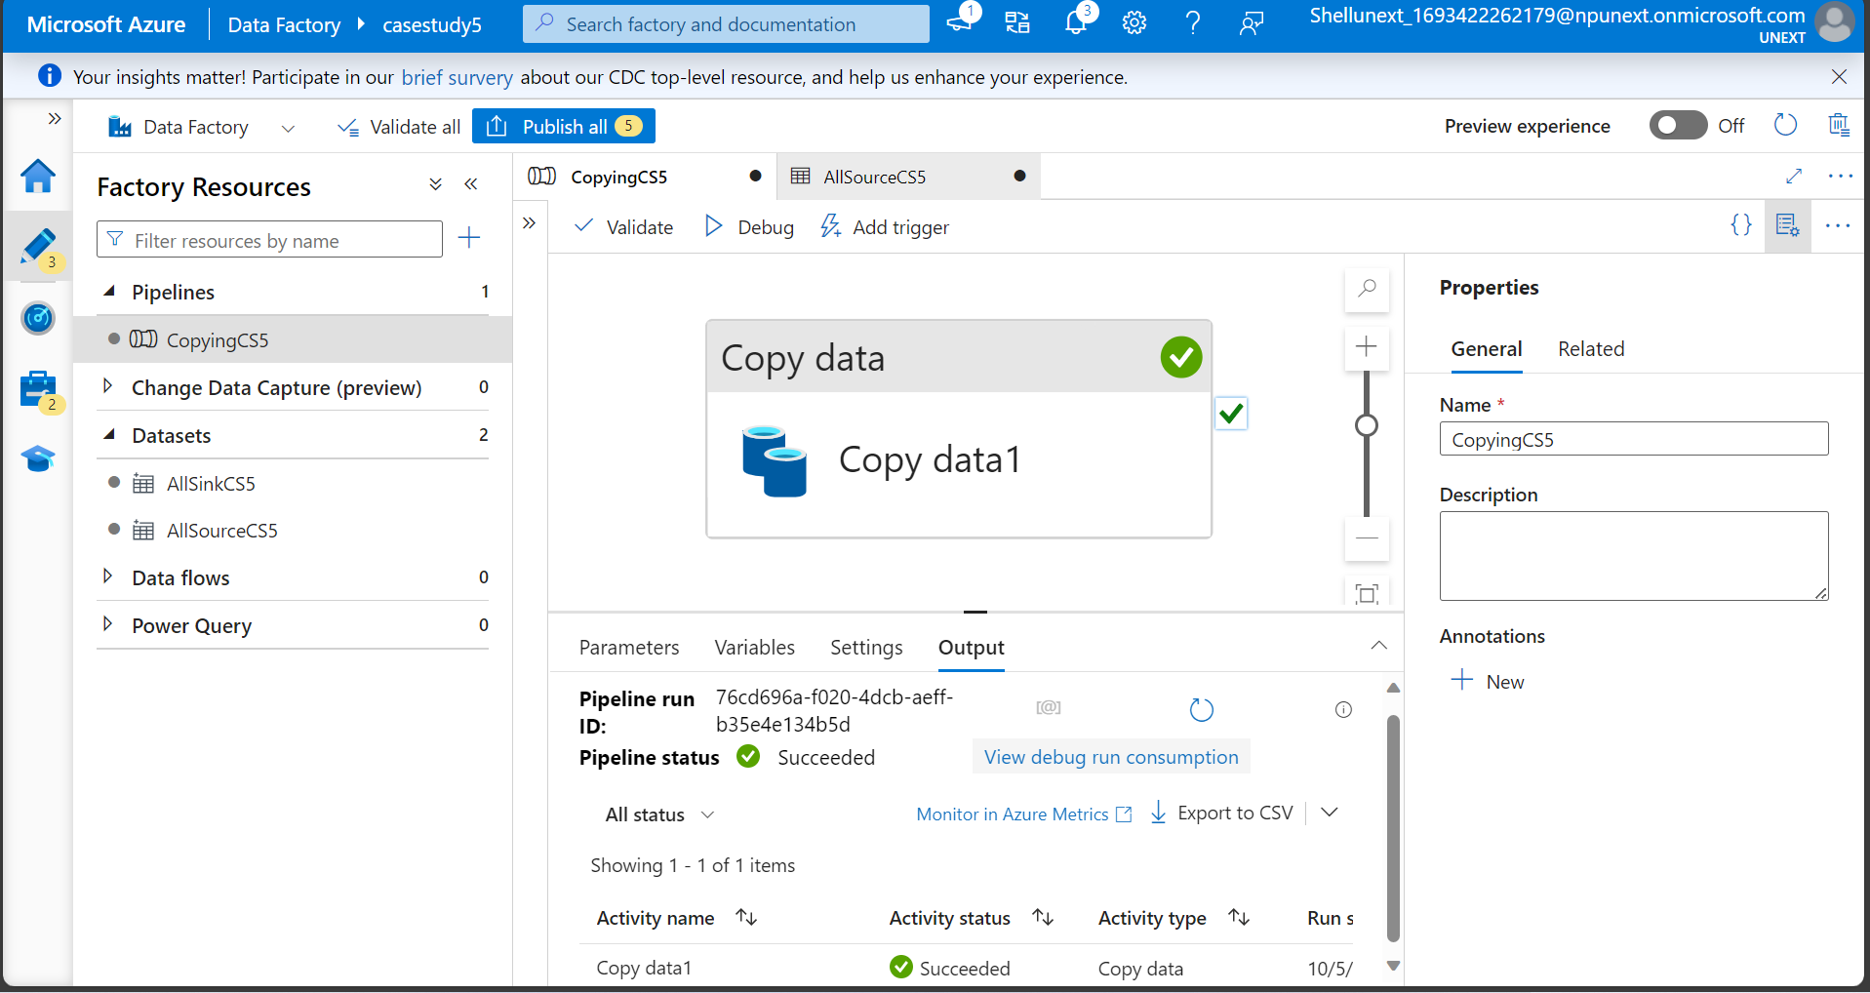
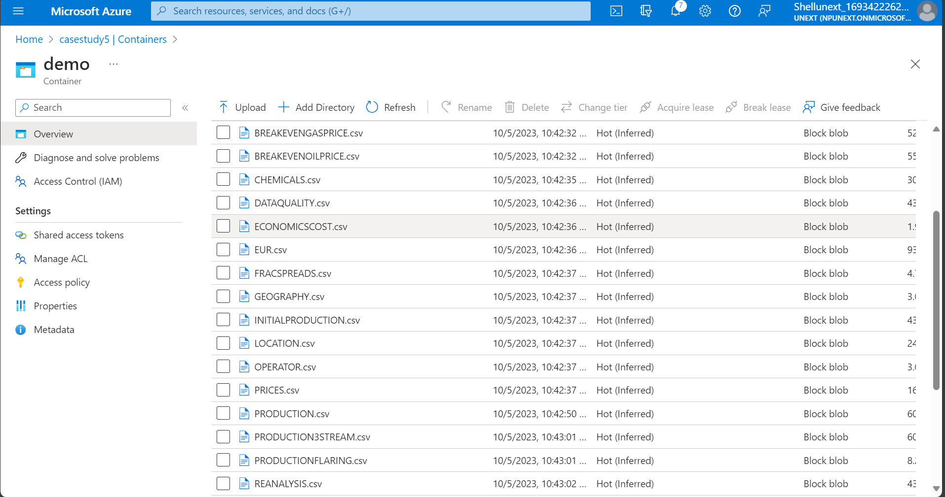
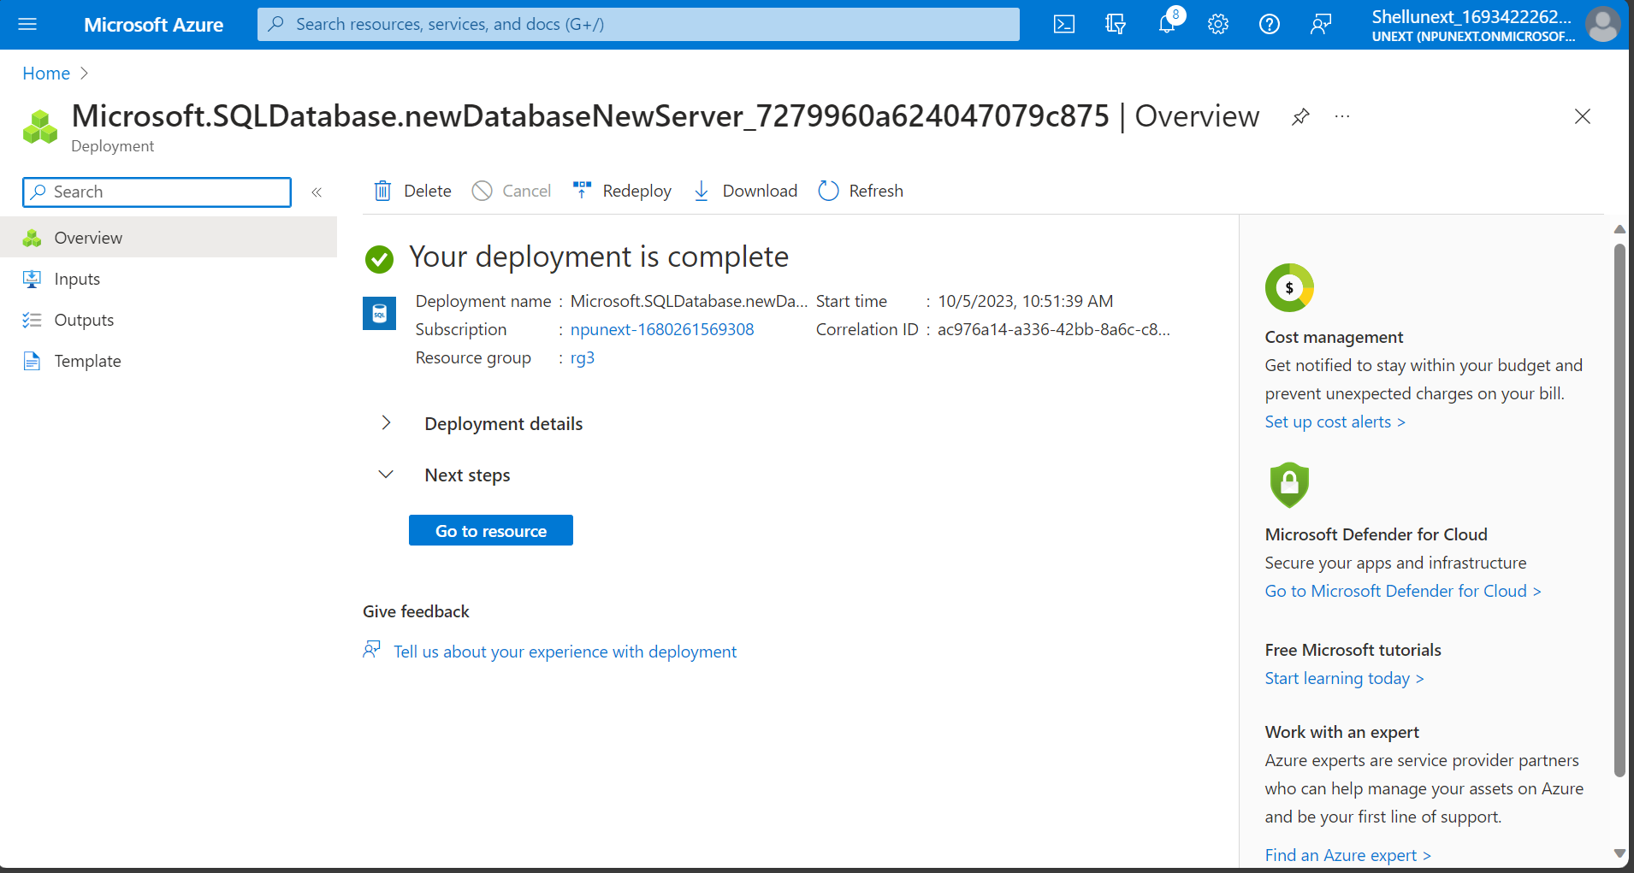

Slide 7
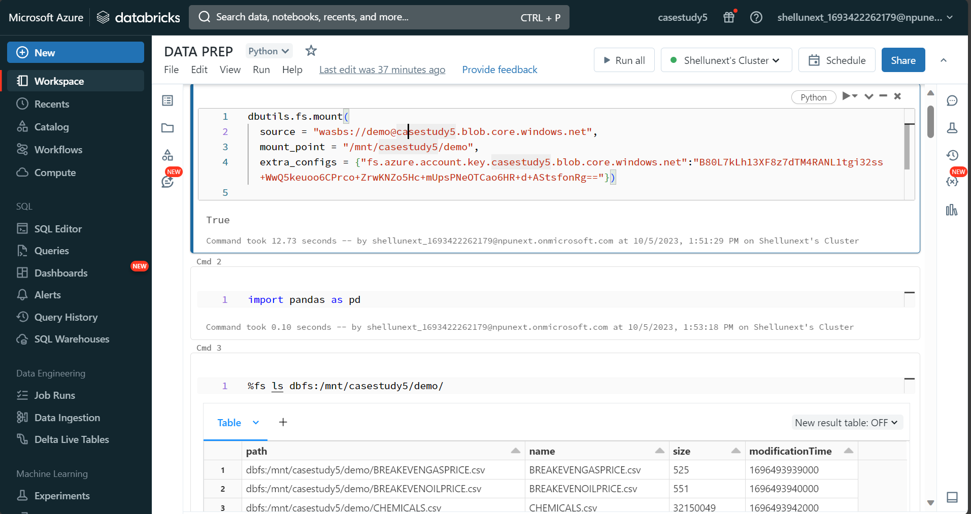
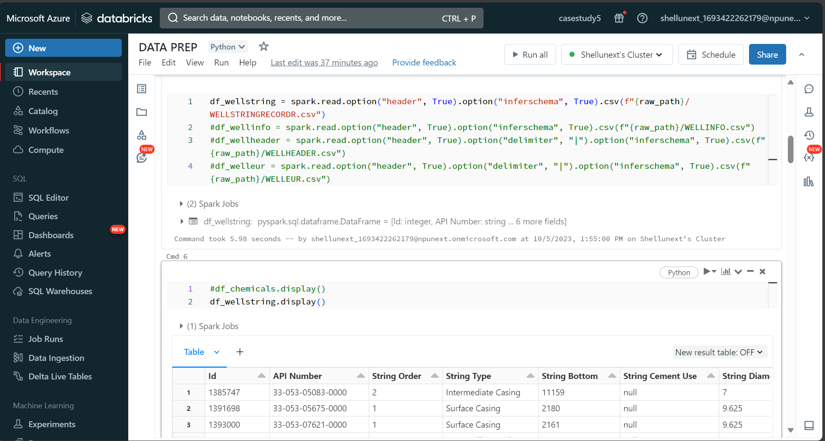
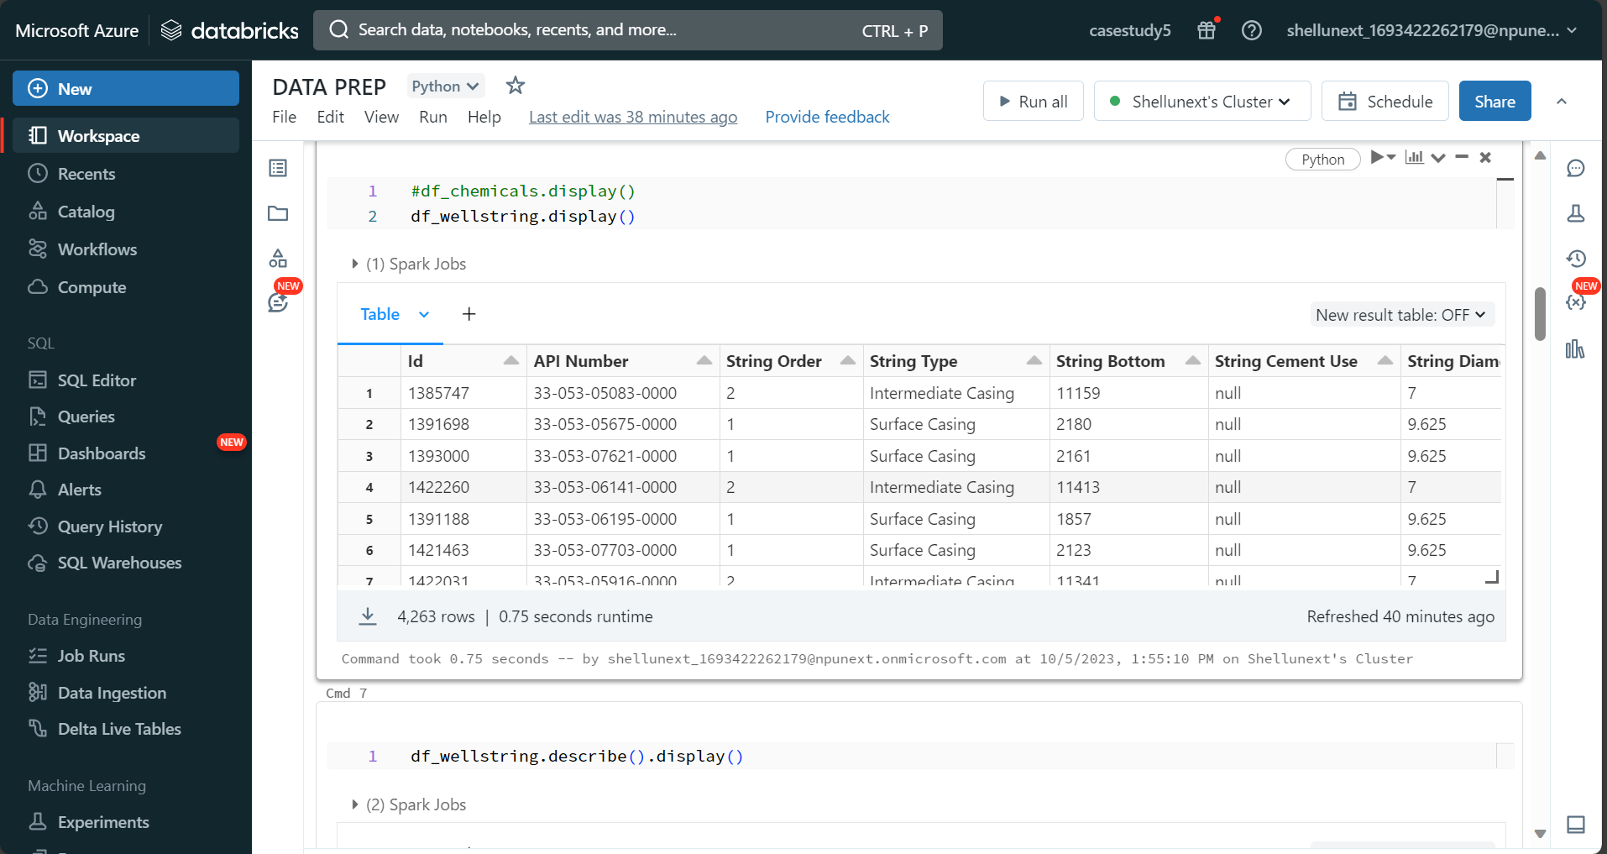
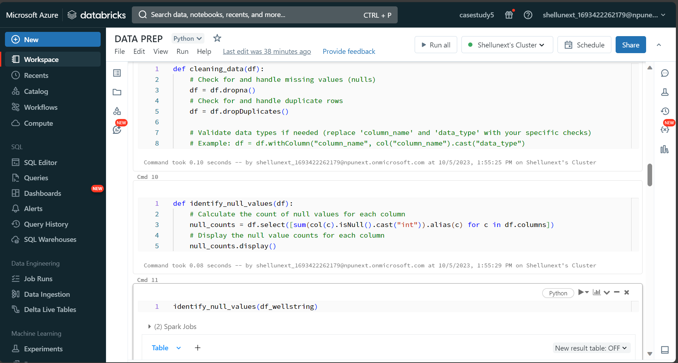

Slide 8
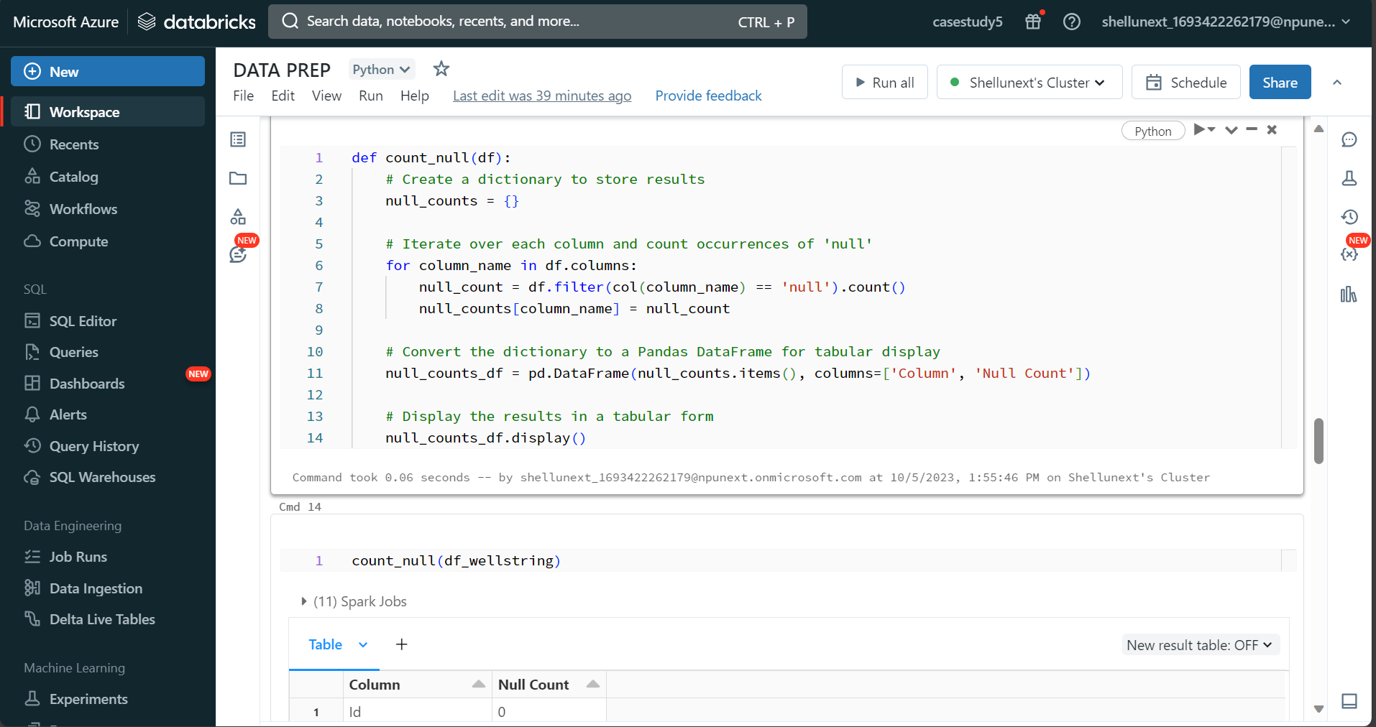
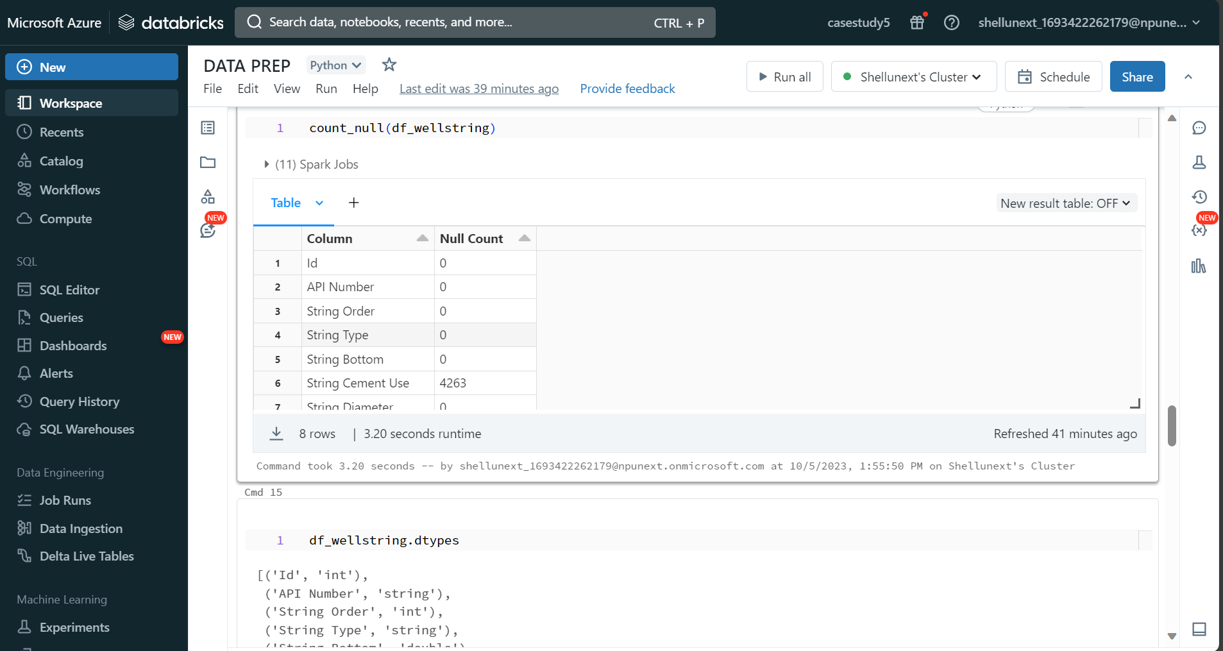
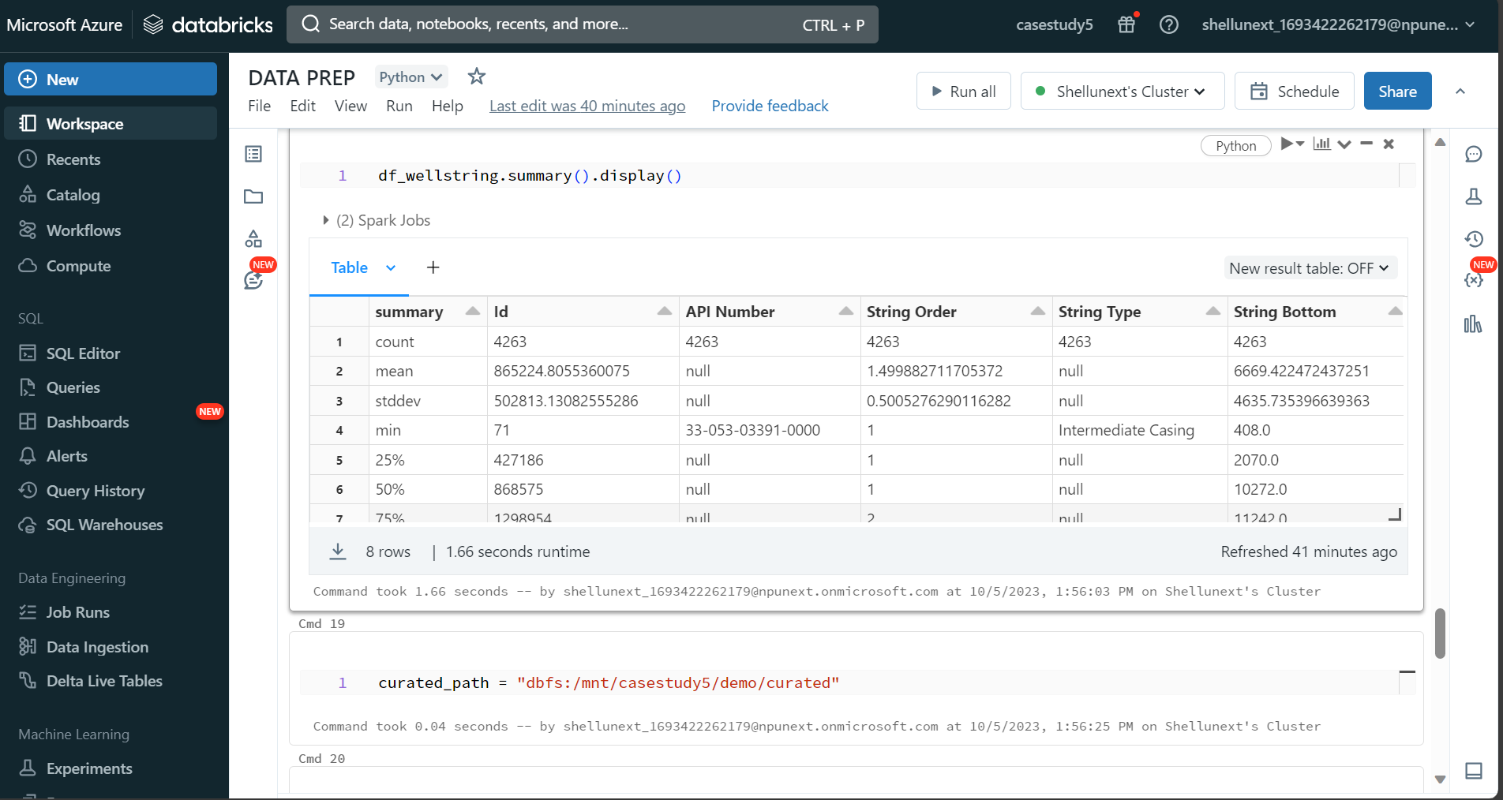
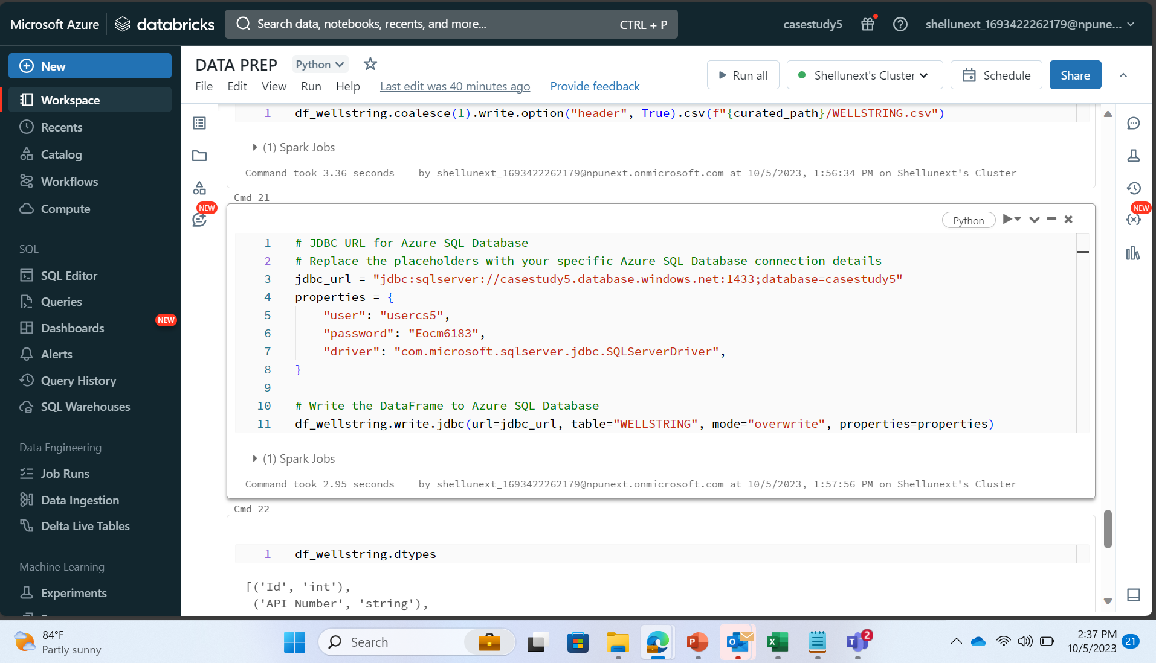

Slide 9
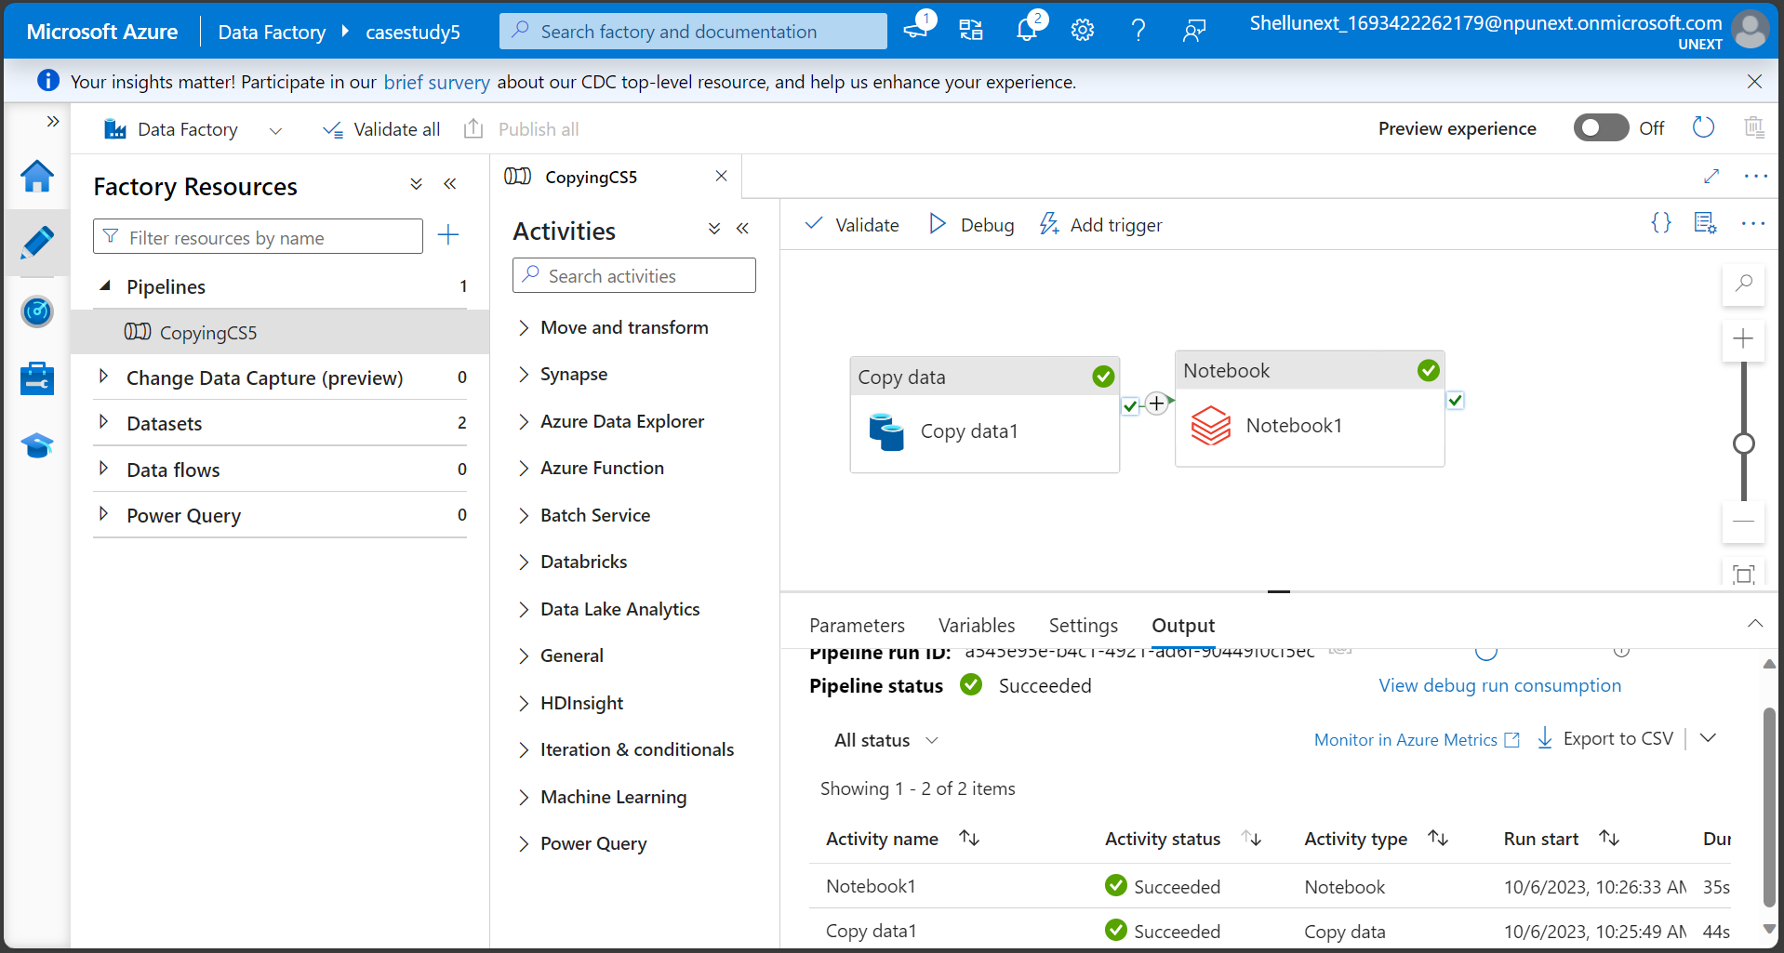

Slide 10
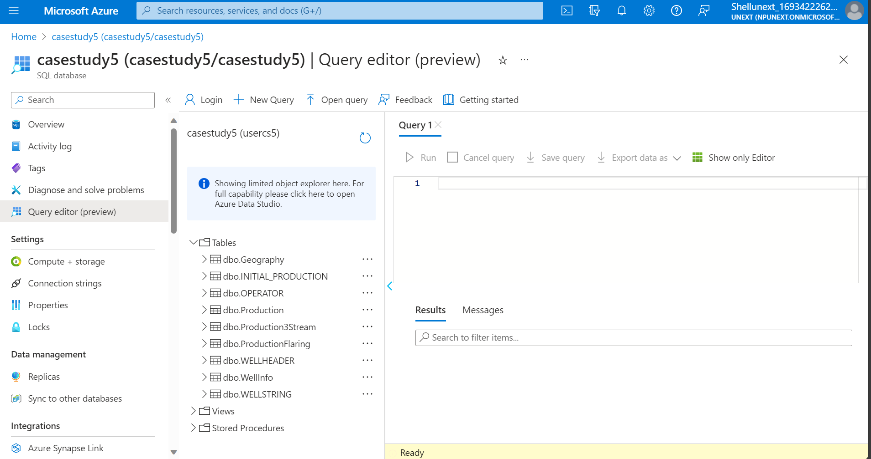
Curated

Slide 11
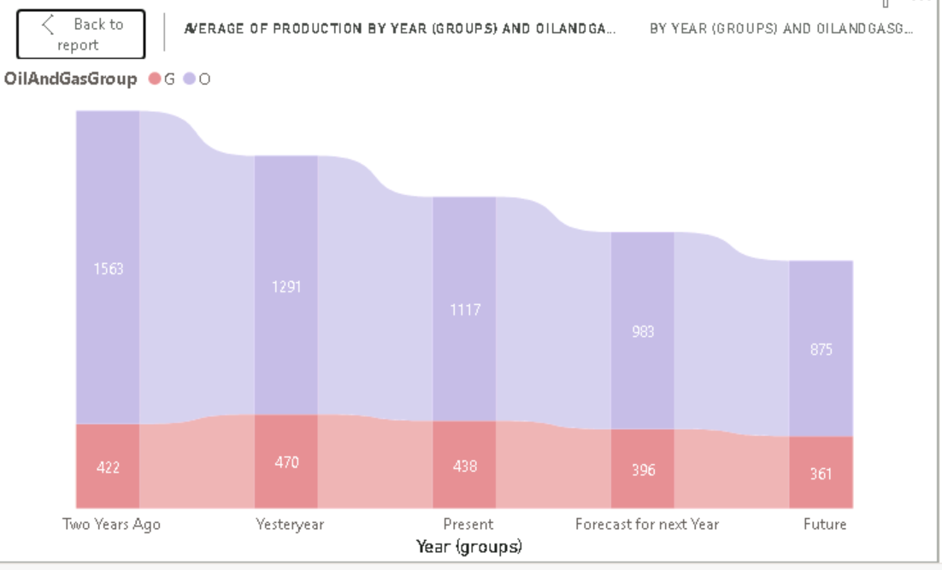
Historical and Forecast Production?

Slide 12
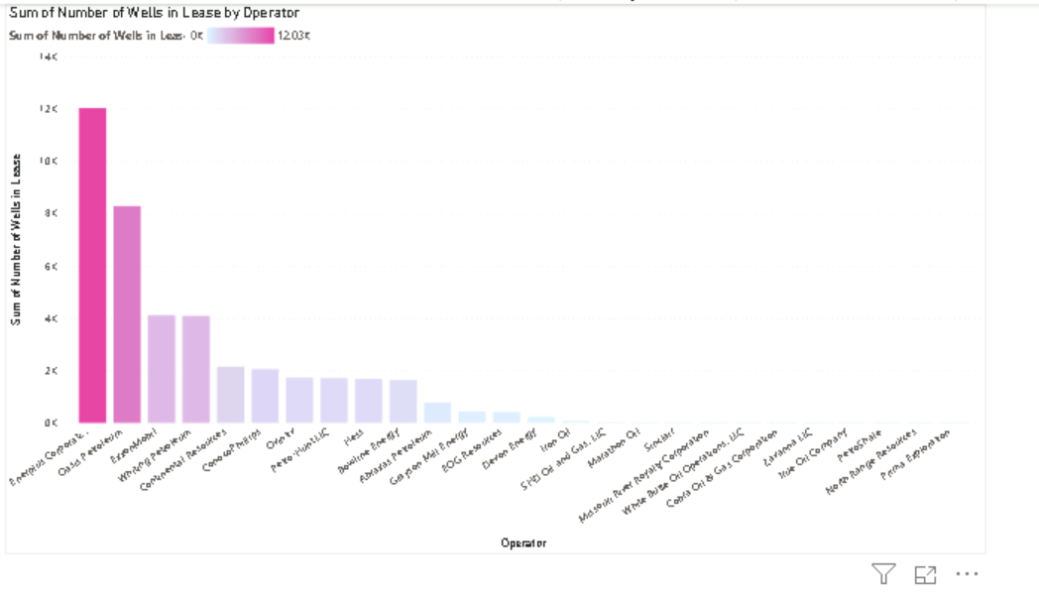
Operators With Highest Well Count?

Slide 13
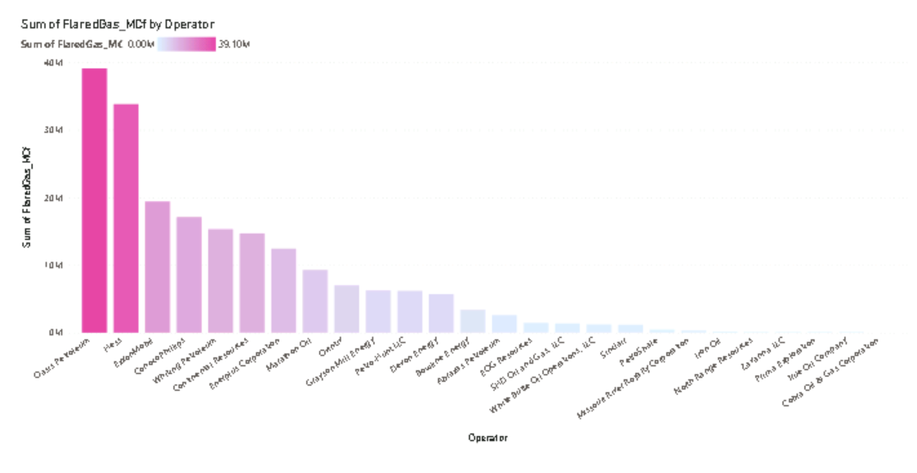
Who are Flaring More?

Slide 14
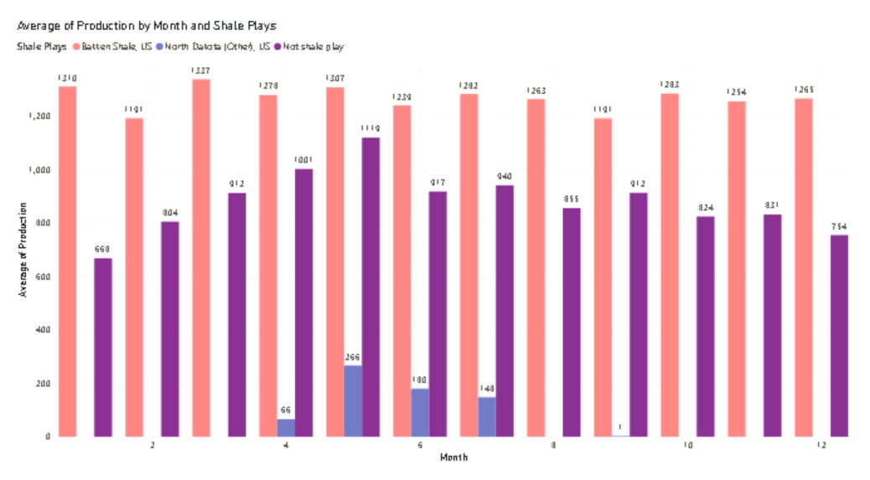
Which shale play has the highest monthly production of oil and gas combined?

Slide 15
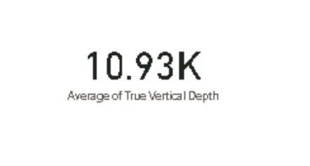
What is the average well length across all wells in the dataset?

Slide 16
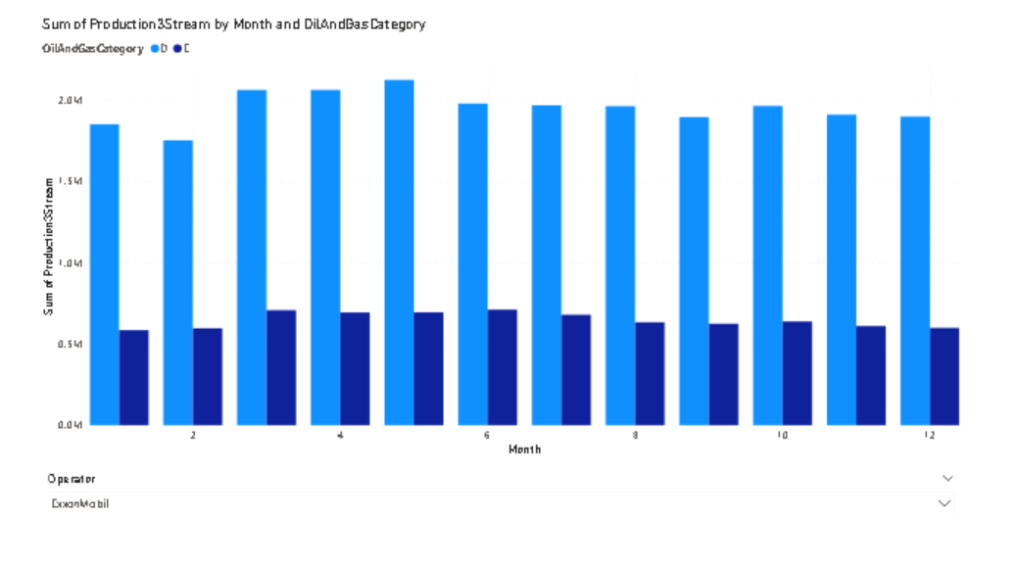
How does the monthly production of Ethane compare to that of dry gas for a specific operator?

Slide 17
Github Link:
https://github.com/nabihaakhann/WellAnalysis.git

